Slide 1
UMass Lowell Computer Science 91.404
Analysis of Algorithms
Prof. Karen Daniels
Spring, 2008
Heap Lecture
Chapter 6
Use NOTES feature to see explanation accompanying some slides.
Pseudo-code is from Cormen et al. textbook.

Slide 2
Heap Basics
16
Structure:
  Nearly complete binary tree
  Convenient array representation
HEAP Property: (for MAX HEAP)
  Parent’s label not less than that of each child
14
10
8
7
9
3
2
4
1
16
14
10
8
7
9
3
2
4
1
1 2 3 4 5 6 7 8 9 10
Notes:
From a structural point of view, we define a heap as a nearly complete binary tree. This structure allows us to conveniently represent a HEAP in an array because it is easy to find the position in the array of each node’s parent and children.
The other part of a HEAP’s definition relates to the values of node labels. In a MAX-HEAP, the value of each node is not smaller than the value of either child. Similarly, in a MIN-HEAP, the value of each node is not larger than the value of either child. We call this relationship the HEAP PROPERTY. Note that it provides a guarantee about the relative label sizes for parents with respect to children. However, there is no guarantee about the relative sizes of sibling labels with respect to each other.

Slide 3
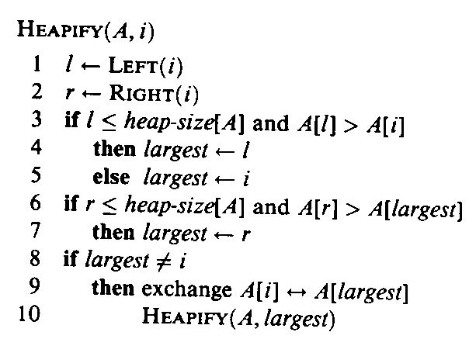
Operations on a Heap
assuming array representation
HEAPIFY:
  for a given node that is the root of a subtree, if both subtrees of that node are already HEAPs, HEAPIFY enforces the HEAP PROPERTY via “downward swaps” so that the node together with its subtrees form a HEAP
16
14
10
8
7
9
3
2
4
1
16
14
10
8
7
9
3
2
4
1
1 2 3 4 5 6 7 8 9 10

Slide 4
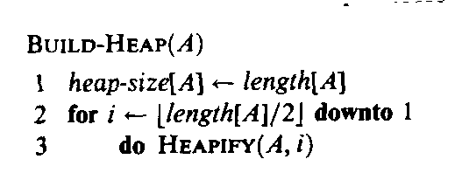
Operations on a Heap
assuming array representation
BUILD-HEAP:
  builds a HEAP from scratch using HEAPIFY
16
14
10
8
7
9
3
2
4
1
16
14
10
8
7
9
3
2
4
1
1 2 3 4 5 6 7 8 9 10

Slide 5
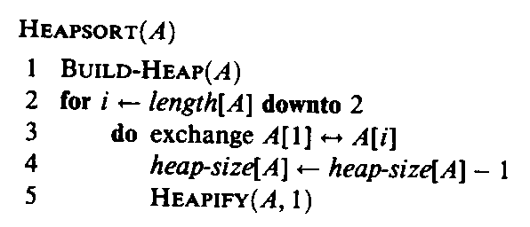
Operations on a Heap
assuming array representation
HEAPSORT:
  sorts an array by first using BUILD-HEAP then repeatedly swapping out root and calling HEAPIFY
16
14
10
8
7
9
3
2
4
1
16
14
10
8
7
9
3
2
4
1
1 2 3 4 5 6 7 8 9 10

Slide 6
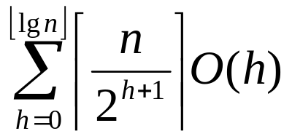
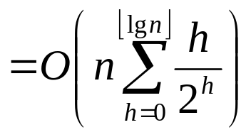
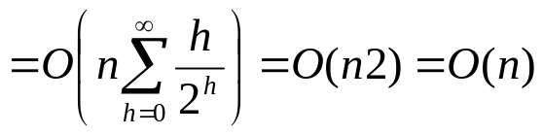
Operations on a Heap
assuming array representation
HEAPIFY:
BUILD-HEAP:
HEAPSORT:
T(n) = T(2n/3) + Θ(1)
is in O(lgn) using Master Theorem
Asymptotic worst-case running time is in O(lg n).
For a node at height h, time is in O(h).
Asymptotic worst-case running time is in O(n lg n). However this is a loose bound! Time is also in O(n).
O(n)
+
Asymptotic worst-case running time is in O(n lg n).
nO(lgn)
O(lgn)

Slide 7
Operations on a Heap
assuming array representation
PRIORITY QUEUE SUPPORT:
  HEAP-INSERT
    adds new leaf to the tree and then “swaps up” to restore HEAP PROPERTY
  HEAP- MAXIMUM
    HEAP PROPERTY guarantees that maximum is at the root of a MAX HEAP
  HEAP- EXTRACT-MAX
    removes the maximum value from the root by swapping it out
    restores HEAP PROPERTY using HEAPIFY
Applications: Job Scheduling, Event Scheduling

Slide 8
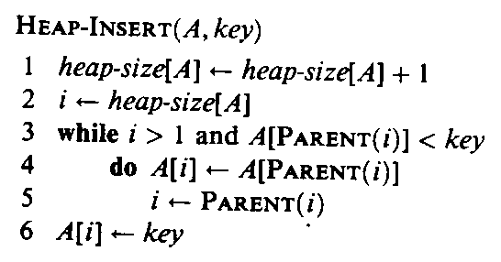
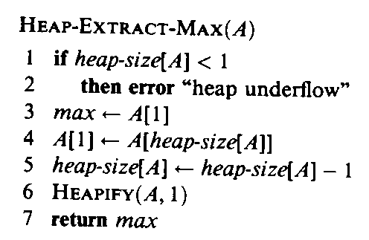
Operations on a Heap
assuming array representation
PRIORITY QUEUE SUPPORT:
  HEAP-INSERT
  HEAP- MAXIMUM
  HEAP- EXTRACT-MAX
Asymptotic worst-case running time is in O(lg n).
For a node at height h, time is in O(h).
Asymptotic worst-case running time is in O(1).
O(1)
Asymptotic worst-case running time is in O(lg n).
+
For a node at height h, time is in O(h).
O(lgn)

Slide 9
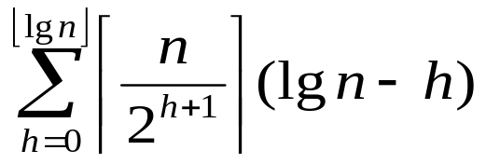
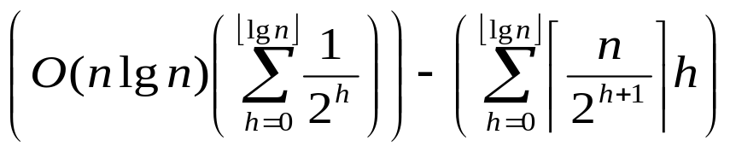
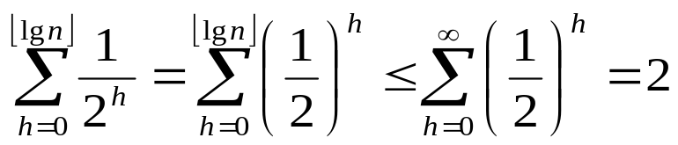

Building a Heap using
HEAPIFY vs. HEAP-INSERT
HEAPIFY
  swaps down
  compares parent with both children before each swap
16
HEAP-INSERT
  swaps up
  compares parent with one child before each swap
14
10
8
7
9
3
2
4
1
number of levels
maximum number of swaps = length of path from this level up to root
number of levels
maximum number of swaps = length of path from this level down to leaf
number of nodes in this level
number of nodes in this level
O(n) as in HEAPIFY
Asymptotic worst-case running time of BUILD-HEAP using HEAPIFY is in O(n). However, using HEAP-INSERT the time would only be in O(n lg n).

